Slide 1



Parkinson’s Research: the Neuroprogressive & Dementia Research Network
Celebrating Scottish Research Conference
13 June 2024
Gordon Duncan
NHS Lothian & University of Edinburgh

Slide 2
Disclosures
NHS Lothian NRS Clinician
NHS Lothian PI clinical studies
Lecture & Travel fees: GE Healthcare and Bial

Slide 3
Key messages
Parkinson’s is a common neurodegenerative disorder
Complex disease (s): many body systems involved, and everyone’s experience is different
Research is vital to better understand how Parkinson’s evolves and develop better treatments
NDN supports an expanding portfolio of clinical studies for Parkinson’s and related disorders in Scotland
Notes:
In Scotland approx. 13000

Slide 4
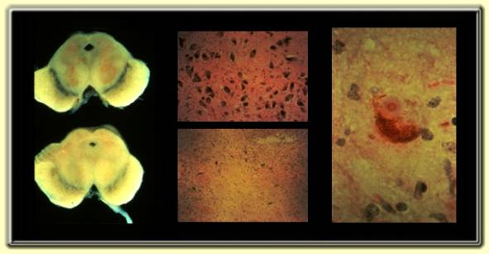
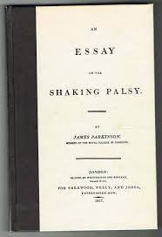
Parkinson’s disease
1817 – Dr James Parkinson
Loss of neurones
Dopaminergic
Cholinergic
Noradrenergic
Serotonergic

Slide 5
Motor & Movement
Bradykinesia
Walking, manual dexterity, speech, swallowing, self-care
Tremor
Resting
Rigidity
Stiffness in limbs
Postural instability and falls

Slide 6
Non
Motor
Features
Cognitive & Neuropsychiatric
Dementia, cognitive impairment, depression, anxiety, apathy, hallucinations, delusions, psychosis
Autonomic
Constipation, urinary urgency, orthostatic hypotension, sweating, fatigue
Sleep
Rapid eye movement sleep behaviour disorder, excess daytime sleepiness, sleep fragmentation

Slide 7
Research is vital to address unmet needs
Therapies to stop, slow or reverse the pathological progression of Parkinson’s
Better treatments of complex motor problems
Effective treatments for non-motor features
  Constipation, sleep, mood, memory, thinking, sleep, low blood pressure, urinary, sweating…

Slide 8
Parkinson’s studies and the NDN
Disease–modifying
Symptoms: Motor and Non-motor
Bial - Activate
Luma/Lighthouse
PADOVA
Exenatide
PD Probiotic
ASPro
EJS-ACT (PD MAMS)
Understanding PD and Genetics
ROPAD
LIPAD
PD Frontline
Complex motor: AbbVIe Pump
Falls: CHIEF-PD
Voice and Speech: PD COMM
Urinary symptoms: START-UP
PD Dementia: COBALT
Hallucinations: TOPHAT and CANPDP
Deep Brain Stimulation: Vercise

Slide 9


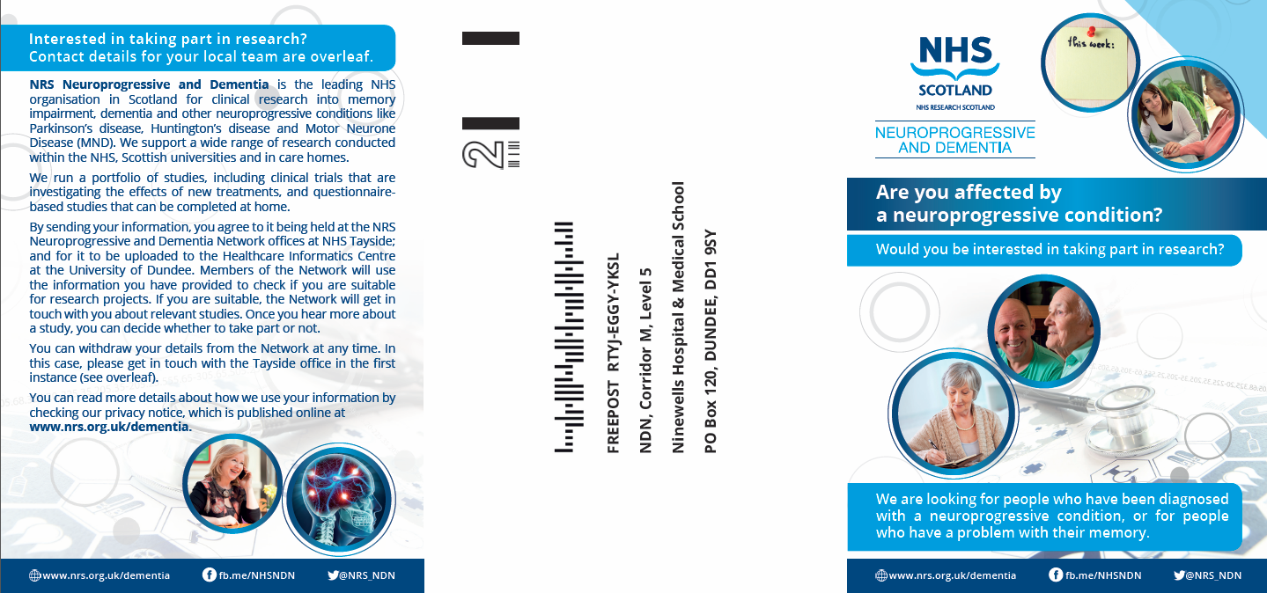



Delivering research excellence in NHS Lothian
Permission to Contact
A tri-fold leaflet developed for patients
Person completes Permission to Contact form
Registers their interest in research
Details held on a secure database in HIC
No obligation to take part
Gives NDN permission to contact you about research
PTC forms can be sent out with appointment letters or given to patients during or after clinic visits
www.nrs.org.uk
@NHSResearchScot
NHS Research Scotland

Slide 10
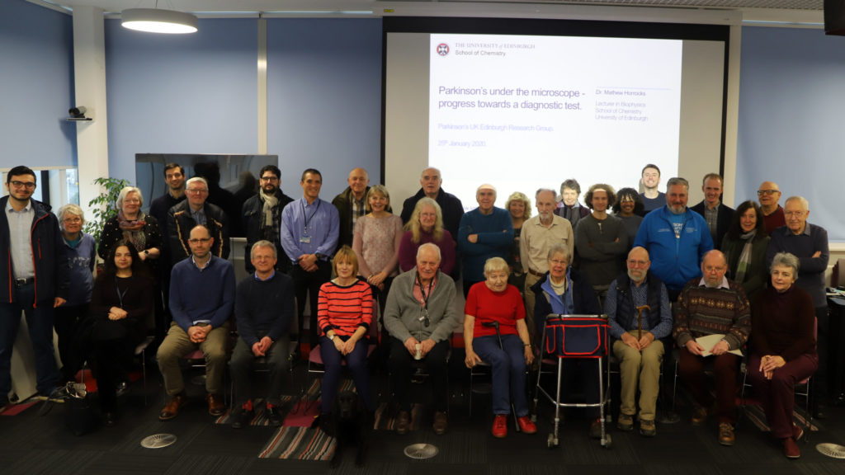
Research Interest Groups – throughout Scotland

Slide 11
Research Information: UK and beyond
Parkinson’s UK
https://www.parkinsons.org.uk/research/take-part-research
Research Interest Groups
https://www.edinburghparkinsons.org/research-interest/
Cure Parkinson’s
https://cureparkinsons.org.uk/
Michael J Fox Foundation
https://www.michaeljfox.org/
No Silver Bullet
https://nosilverbullet4pd.com/

Slide 12

Thank you

Slide 13
Parkinson’s Research: the Neuroprogressive & Dementia Research Network
Celebrating Scottish Research Conference
13 June 2024
Gordon Duncan
NHS Lothian & University of Edinburgh

Slide 14
Disclosures
NHS Lothian NRS Clinician
NHS Lothian PI clinical studies
Lecture & Travel fees: GE Healthcare and Bial

Slide 15
Key messages
Parkinson’s is a common neurodegenerative disorder
Complex disease (s): many body systems involved, and everyone’s experience is different
Research is vital to better understand how Parkinson’s evolves and develop better treatments
NDN supports an expanding portfolio of clinical studies for Parkinson’s and related disorders in Scotland
Notes:
In Scotland approx. 13000

Slide 16
Parkinson’s disease
1817 – Dr James Parkinson
Loss of neurones
Dopaminergic
Cholinergic
Noradrenergic
Serotonergic

Slide 17
Motor & Movement
Bradykinesia
Walking, manual dexterity, speech, swallowing, self-care
Tremor
Resting
Rigidity
Stiffness in limbs
Postural instability and falls

Slide 18
Non
Motor
Features
Cognitive & Neuropsychiatric
Dementia, cognitive impairment, depression, anxiety, apathy, hallucinations, delusions, psychosis
Autonomic
Constipation, urinary urgency, orthostatic hypotension, sweating, fatigue
Sleep
Rapid eye movement sleep behaviour disorder, excess daytime sleepiness, sleep fragmentation

Slide 19
Research is vital to address unmet needs
Therapies to stop, slow or reverse the pathological progression of Parkinson’s
Better treatments of complex motor problems
Effective treatments for non-motor features
  Constipation, sleep, mood, memory, thinking, sleep, low blood pressure, urinary, sweating…

Slide 20
Parkinson’s studies and the NDN
Disease–modifying
Symptoms: Motor and Non-motor
Bial - Activate
Luma/Lighthouse
PADOVA
Exenatide
PD Probiotic
ASPro
EJS-ACT (PD MAMS)
Understanding PD and Genetics
ROPAD
LIPAD
PD Frontline
Complex motor: AbbVIe Pump
Falls: CHIEF-PD
Voice and Speech: PD COMM
Urinary symptoms: START-UP
PD Dementia: COBALT
Hallucinations: TOPHAT and CANPDP
Deep Brain Stimulation: Vercise

Slide 21
Delivering research excellence in NHS Lothian
Permission to Contact
A tri-fold leaflet developed for patients
Person completes Permission to Contact form
Registers their interest in research
Details held on a secure database in HIC
No obligation to take part
Gives NDN permission to contact you about research
PTC forms can be sent out with appointment letters or given to patients during or after clinic visits
www.nrs.org.uk
@NHSResearchScot
NHS Research Scotland

Slide 22
Research Interest Groups – throughout Scotland

Slide 23
Research Information: UK and beyond
Parkinson’s UK
https://www.parkinsons.org.uk/research/take-part-research
Research Interest Groups
https://www.edinburghparkinsons.org/research-interest/
Cure Parkinson’s
https://cureparkinsons.org.uk/
Michael J Fox Foundation
https://www.michaeljfox.org/
No Silver Bullet
https://nosilverbullet4pd.com/

Slide 24
Thank you

